Slide 1
Fundamentals of
Machine Learning
Key Concepts from Deep Learning with Python
Chapters 5 & 6

Slide 2
The Central Tension
Optimization
Generalization
Minimize loss on training data
Perform well on unseen data
Goal: Make the model fit the data you have
• Adjust weights to reduce errors
• Gradient descent finds minima
• More capacity = better fit
Tries to fit a ‘perfect’ decision boundary
vs
Goal: Learn patterns that transfer
• Avoid memorizing noise
• Capture underlying structure
• The REAL objective of ML
Too perfect! You start making all kinds of weird little nuanced decisions that aren’t generally relevant.
The goal of ML is generalization, but we can only optimize on training data

Slide 3
Underfitting & Overfitting
UNDERFITTING
GOOD FIT
OVERFITTING
Model is too simple
Model captures patterns
Model memorizes noise
✓
📉
〰️
High training error
High validation error
Low training error
Low validation error
Low training error
High validation error
The sweet spot: Complex enough to learn patterns, simple enough to generalize

Slide 4
What Causes Overfitting?
🎲
❓
💎
Noisy Data
Ambiguous Features
Rare Features
Training data contains random errors or irrelevant variations
Model learns these spurious patterns instead of true signal
Solution(s)?
Features that correlate with labels by chance in training set
These correlations don't hold in new data
Solution(s)?
Features that appear in very few training examples
Model overfits to these specific cases
Solution(s)?

Slide 5
The Manifold Hypothesis
Why machine learning is even possible
The Key Insight
Imagine...
Real-world data doesn't fill the entire possible space randomly.
Instead, it lies on lower-dimensional manifolds — structured surfaces within the high-dimensional space.
Example: Images of faces form a tiny subset of all possible pixel combinations.
A 256×256 grayscale image has
65,536 dimensions
But valid images of ‘dogs’ occupy a tiny curved surface in that space.
Our predictive model is learning to navigate that surface, i.e., the manifold.
This is why interpolation works: nearby points on the manifold have similar properties

Slide 6
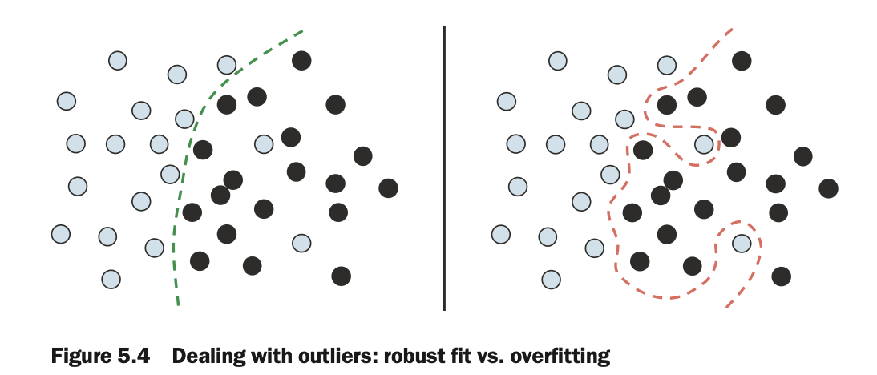
Contextualized: Neural Network
It’s learning a decision rule that relates X’s and Y. It tries to learn a decision boundary to separate the classes cleanly (left is a ‘good’ generalizable decision rule, but right is overfit).

Slide 7
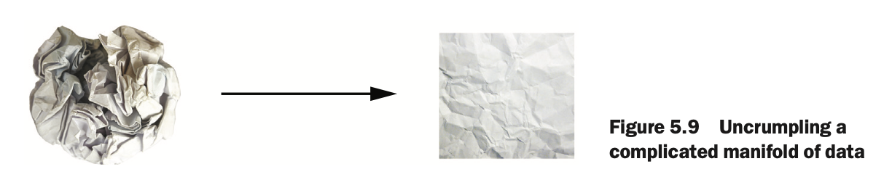
Warp Data Space to Make the Manifold ‘Simple’ (Linear)

Slide 8
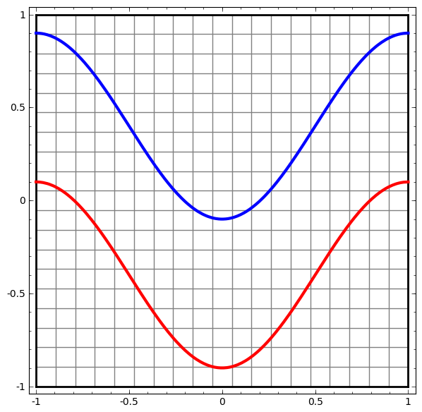
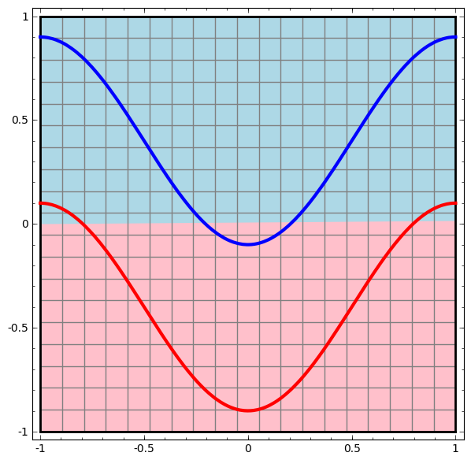
What a Neural Network is Doing
It’s learning a decision rule that relates X’s (x1 and x2 here) and Y (blue vs. red in this case). Data generated on the left, and a 1-node neural network on the right (single output node, tanh). It tries to learn a linear decision boundary to separate the classes cleanly (and fails).

Slide 9
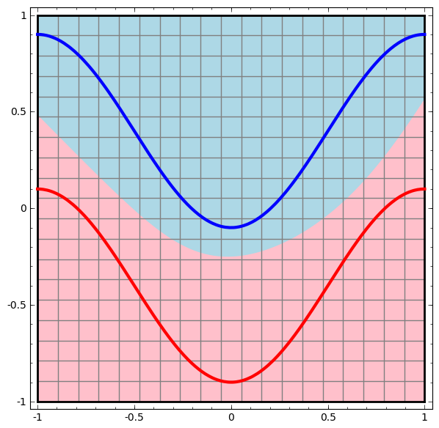
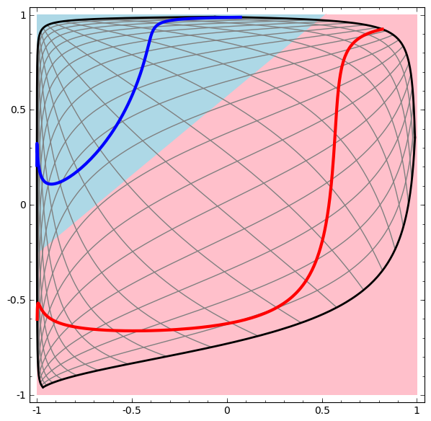
What a Neural Network is Doing
Data generated on the left, and a neural network with a hidden layer on the right (tanh activation in the hidden layer, two nodes). It learns a curvilinear decision boundary to separate the classes cleanly (and succeeds!).
Data
Data + Decision Rule
Data / Decision Rule in Tanh (Warped) Space

Slide 10
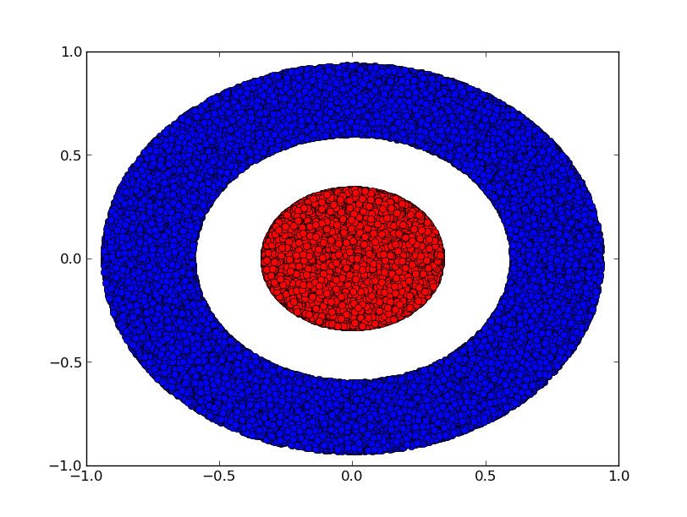
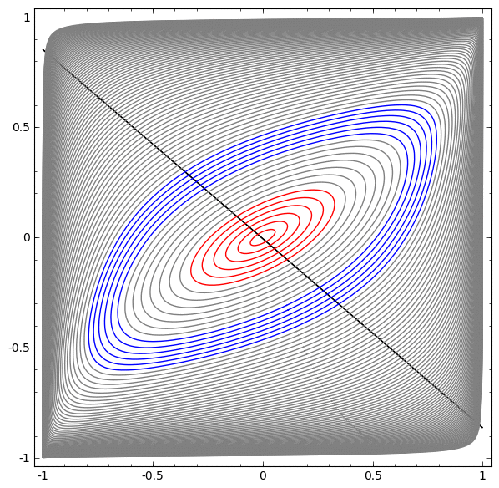
What a Neural Network is Doing
Data generated on the left (x1, x2 with color label), and a neural network with a hidden layer (two nodes) on the right (tanh activation). It tries to learns a curvilinear decision boundary to separate the classes cleanly (and fails!).
Data
Data + Learning a Decision Rule

Slide 11
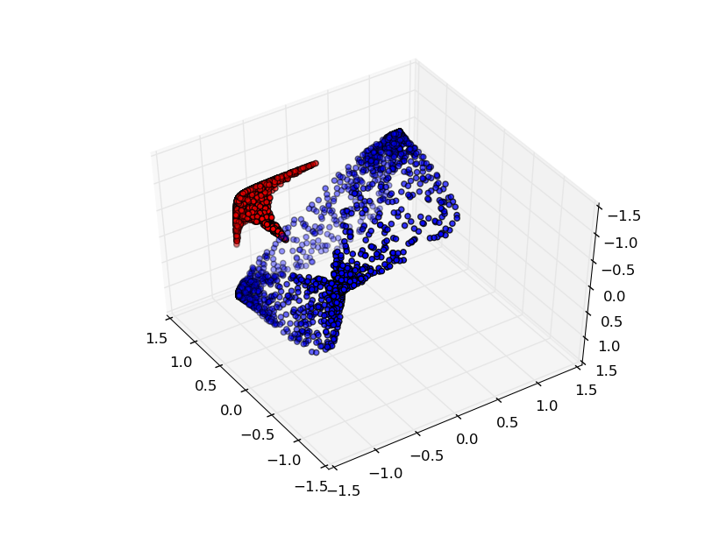
What a Neural Network is Doing
Data generated on the left, and a neural network with a hidden layer (three nodes) on the right (tanh activation). It tries to learn a non-linear hyperplane decision boundary to separate the classes cleanly (and succeeds!).
Data
Data + Decision Rule

Slide 12
Model Evaluation
Train / Validation / Test Split
Training Set (60-80%)
Val (10-20%)
Test (10-20%)
Training Set
Validation Set
Test Set
Used to fit the model
• Update weights via gradient descent
• Model sees this data repeatedly
Used to tune hyperparameters
• Choose architecture
• Select regularization strength
• Decide when to stop training
Final performance estimate
• Only use ONCE at the end
• No further tuning after this!
• Estimates real-world performance
Information leak: If you tune based on test performance, your test set becomes another validation set!

Slide 13
Evaluation Methods
Final score = average of all K validation scores
Simple Hold-out
K-Fold Cross-Validation
Split data once into train/val/test
✓ Simple and fast
✗ High variance with small datasets
Split into K parts, rotate validation
✓ More reliable estimate
✗ K times more expensive
Training
Validation
K-Fold Visualization (K=5)
Fold 1:
Fold 2:
Fold 3:
Fold 4:
Fold 5:

Slide 14
Improving Model Fit
Getting started: First, achieve a model that overfits
1
Tune Learning Rate
2
Increase Batch Size
3
Train Longer
Too high = unstable, too low = slow convergence
More stable gradients, but requires tuning LR
More epochs to reach convergence
Why Overfit First?
If your model can't overfit the training data, it doesn't have enough capacity to learn the patterns. Start with a model that overfits, then add regularization.
Architecture Priors That Help
Convolutions
Recurrence
Attention
For spatial patterns in images
For sequential data
For relating distant elements

Slide 15
Increasing Model Capacity
Add More Layers
Add More Units
Deeper networks can learn more complex hierarchies
Each layer adds another level of abstraction
But: vanishing gradients become an issue
Wider layers can capture more features per level
More parameters = more expressive power
But: risk of overfitting increases
Python Example: Increasing Capacity
# Start with a small model
model = keras.Sequential([
layers.Dense(32, activation='relu'), # Increase to 64, 128...
layers.Dense(1, activation='sigmoid') ])

Slide 16
Regularization Techniques
Fighting overfitting while maintaining model capacity
Weight Regularization
Dropout
Add penalty for large weights to loss function
• L1: Encourages sparsity (some weights → 0)
• L2: Encourages small weights (weight decay)
Randomly "drop" neurons during training
• Forces redundant representations
• Prevents co-adaptation of features
Early Stopping
Data Augmentation
Stop training when validation loss stops improving
• Prevents overfitting to training data
• Uses patience parameter to avoid stopping too early
Generate more training data from existing samples
• Images: rotate, flip, crop, color shift
• Text: synonym replacement, back-translation

Slide 17
Weight Regularization
Total Loss = Original Loss + λ × Regularization Term
λ controls the strength of regularization (higher = simpler model)
L1 Regularization (Lasso)
L2 Regularization (Ridge)
Penalty = Σ|w|
Penalty = Σw²
Sum of absolute values of weights
Effect: Drives some weights exactly to zero
Use for: Feature selection, sparse models
Sum of squared weights
Effect: Makes all weights smaller
Use for: General regularization (most common)
Python Example
from tensorflow.keras import regularizers
layers.Dense(64, kernel_regularizer=regularizers.l2(0.001))

Slide 18
Dropout
Randomly disabling neurons during training
Without Dropout
With Dropout (rate=0.5)
All neurons active
~50% randomly dropped each batch
How It Works
1. During training: Randomly set some neuron outputs to 0 (with probability = dropout rate)
2. During inference: Use all neurons, but scale outputs by (1 - dropout rate)
3. Effect: Network can't rely on any single feature — forces robust, distributed representations
layers.Dropout(0.5) # Drop 50% of neurons during training

Slide 19
The Universal ML Workflow
A systematic approach to any machine learning problem
1
2
3
DEFINE
DEVELOP
DEPLOY
Frame the problem
• What are inputs/outputs?
• What data is available?
• What's the success metric?
• What are constraints?
→
Build the model
• Prepare data
• Choose evaluation
• Beat baseline
• Scale & regularize
→
Ship to production
• Export & optimize
• Serve predictions
• Monitor performance
• Maintain over time
Iterate between phases as you learn more about your problem

Slide 20
Data Preparation
Best practices for getting your data model-ready
Vectorization
Normalization
Convert all data to tensors (numeric arrays)
• Text → embeddings or one-hot
• Images → normalized pixel values
• Categories → integer encoding
Scale features to similar ranges
• Subtract mean, divide by std dev
• Or scale to [0, 1] range
• Compute stats on training data only!
Handle Missing Values
Feature Engineering
Neural nets can't handle NaN/None
• Impute with mean/median/mode
• Use 0 if it's a meaningful "missing"
• Add "is_missing" indicator feature
Make patterns easier to learn
• Create derived features (ratios, diffs)
• Encode domain knowledge
• But: deep learning reduces need for this

Slide 21
Deploying Your Model
🌐
📱
💻
REST API
Edge Device
Browser
Server-side inference via HTTP endpoints
TensorFlow Lite, CoreML, ONNX for mobile/embedded
TensorFlow.js for client-side inference
Model Optimization for Deployment
Weight pruning: Remove near-zero weights to reduce model size
Quantization: Convert float32 → int8 for faster inference (4x smaller)
Knowledge distillation: Train smaller model to mimic larger one
Post-Deployment Monitoring
Data drift: Is incoming data similar to training data?
Concept drift: Has the relationship between inputs and outputs changed?
Performance decay: Monitor accuracy metrics over time — retrain when needed

Slide 22
Key Takeaways
1
Generalization is the goal — optimize training loss, but measure validation loss
2
Start with a model that overfits, then add regularization (L2, dropout, early stopping)
3
Use proper evaluation: train/val/test split or K-fold cross-validation
4
Deep learning works because real data lies on low-dimensional manifolds
5
Follow the universal workflow: Define → Develop → Deploy
Now go build something that generalizes!

